Slide 1



AIE342 | Advanced Methods for Data Analysis
Multi-Modal Product Recommendation Engine: A Deep Learning Framework for Personalized Fashion E-Commerce
Aser Mohamed
Mohamed Rady
Mohamed Elsayed
222102487
222200004
222200002
Under the supervision of Prof. Mohamed Meaad and TA: Eng. Abdelkareem Elhawary
Faculty of Computers and Artificial Intelligence

Slide 2






Introduction and Overview
The Challenge
E-commerce growth demands intelligent recommender systems. Traditional methods often suffer from cold-start problems and sparse data, especially in fashion where visual appeal is key.
Our Solution
A robust Multi-Modal Product Recommendation Engine integrating visual, textual, categorical, and behavioral data within a unified deep learning framework.
Key Innovation: Leverages transfer learning (ResNet50) for visual embeddings and TF-IDF for text, combined via a weighted early-fusion mechanism.
Impact: Achieved significant performance improvements, including an 18.7% increase in NDCG@10 and a 53.8% reduction in cold-start Mean Absolute Error (MAE).

Slide 3







Literature Review
Evolution of Recommender Systems
1st Gen (1990s): Rule-based systems - rigid, limited scalability.
2nd Gen (2000s): Collaborative Filtering (CF) - SVD revolutionized, but vulnerable to cold-start.
3rd Gen (2010s): Deep Learning - CNNs enabled feature extraction from unstructured data.
4th Gen (2020s–Present): Multi-Modal Systems - integrating heterogeneous data for holistic understanding.
Key Concepts
Content-Based Filtering (CBF): Recommends items similar to those a user liked, based on item features.
Collaborative Filtering (CF): Predicts preferences by leveraging patterns from similar users or items.
Multi-Modal Learning: Combines diverse data types (visual, text) into unified embeddings.

Slide 4
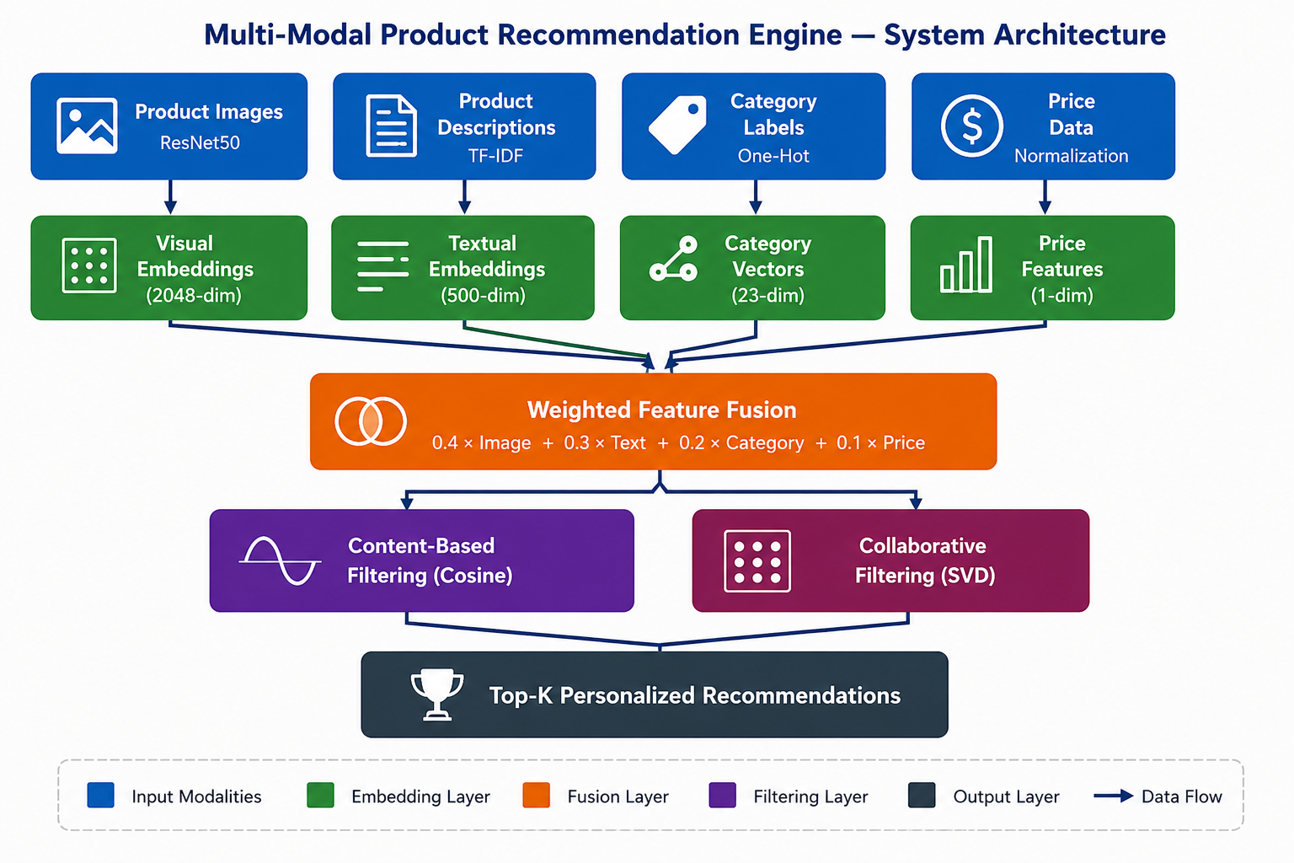





Solution Techniques: System Architecture
Modular Four-Stage Architecture
Stage 1: Data Preprocessing Standardizes raw data through image resizing, text tokenization, and normalization.
Stage 2: Multi-Modal Feature Extraction Parallel modality-specific encoders generate fixed-dimensional vector representations.
Stage 3: Weighted Early-Fusion Integrates heterogeneous feature vectors into a unified latent representation space.
Stage 4: Adaptive Hybrid Engine Dynamically selects and combines algorithms based on user interaction density.
Figure: System Architecture Overview (Figure 1.1 or 3.1 from the report)

Slide 5




Solution Techniques: Feature Extraction & Fusion
Multi-Modal Feature Extraction
Visual (ResNet50)
Textual (TF-IDF)
Pre-trained CNN extracts 2048-dim embeddings capturing shape, texture, and style.
Processes titles and descriptions into 500-dim vectors capturing semantic relationships.
Categorical (One-Hot)
Price (Min-Max)
Encodes 23 fashion classes for structural and domain context.
Normalizes price data to the [0,1] range to prevent numerical dominance.
Weighted Early-Fusion
F
_{fusion}
= 0.4 × V
_{image}
⊕ 0.3 × V
_{text}
⊕ 0.2 × V
_{category}
⊕ 0.1 × V
_{price}
Visual features receive the highest weight (40%) due to their dominance in fashion decision-making.

Slide 6

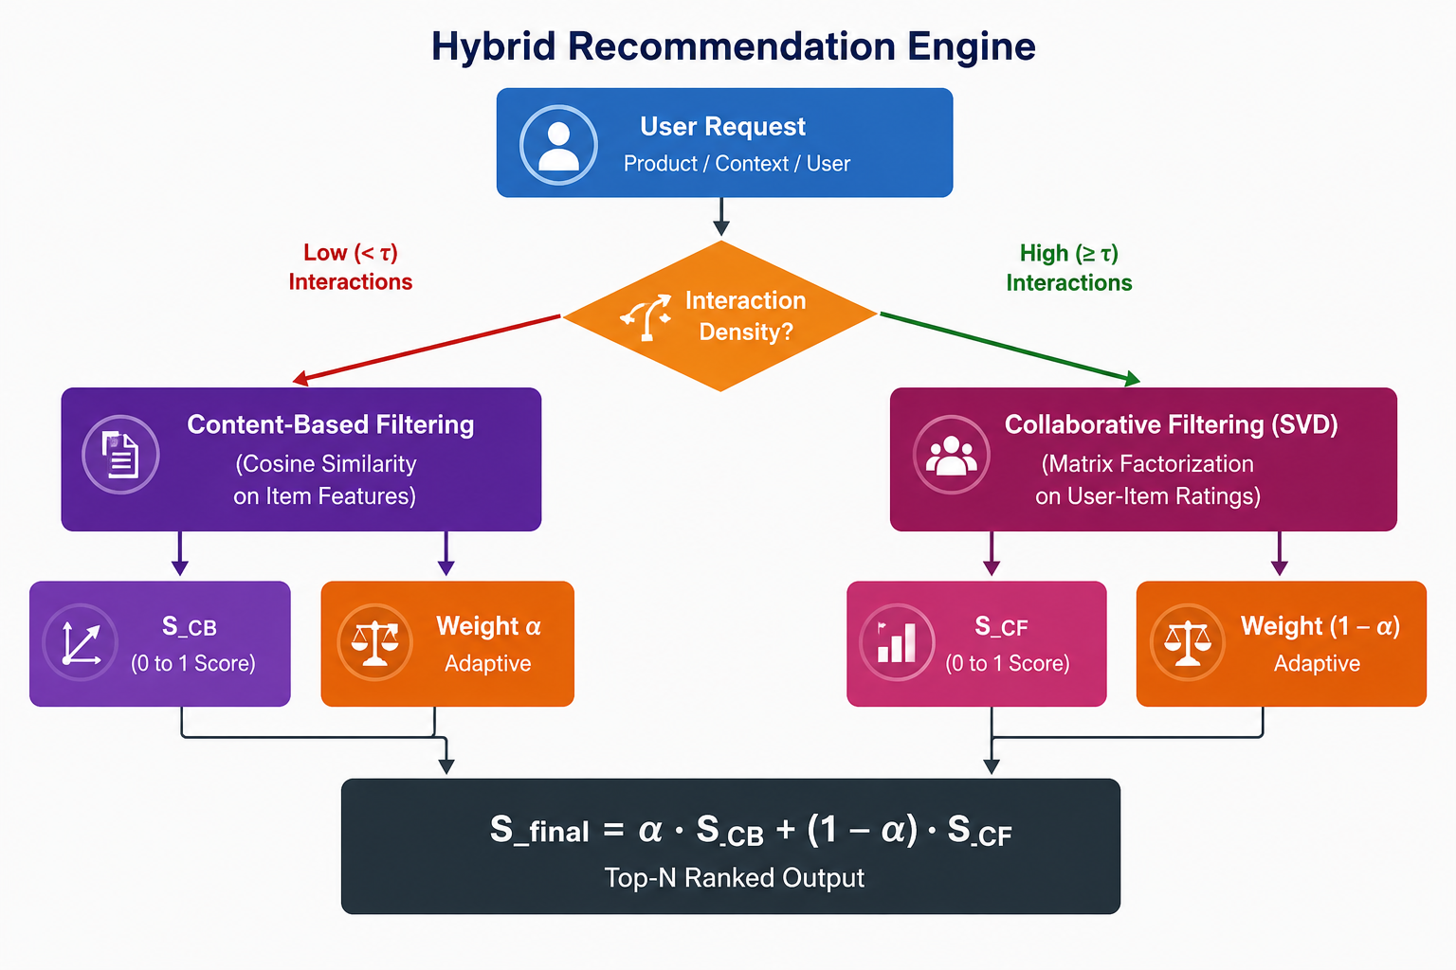



Adaptive Hybrid Recommendation Engine
Dynamic Recommendation Strategy
Cold-Start Users (< 5 interactions): Defaults to Content-Based Filtering (CBF) using fused product embeddings. This provides reliable recommendations even with zero user history.
Active Users (≥ 5 interactions): Employs a weighted combination of Content-Based and Collaborative Filtering (SVD) scores.
Adaptive Weighting: The blending weight (α) adjusts based on user interaction density, prioritizing CF for richer histories.
Final Recommendation Score:
S
_{final}
= α × S
_{CB}
+ (1 - α) × S
_{CF}
Hybrid Recommendation Engine effectively mitigates cold-start limitations and improves overall recommendation quality.

Slide 7
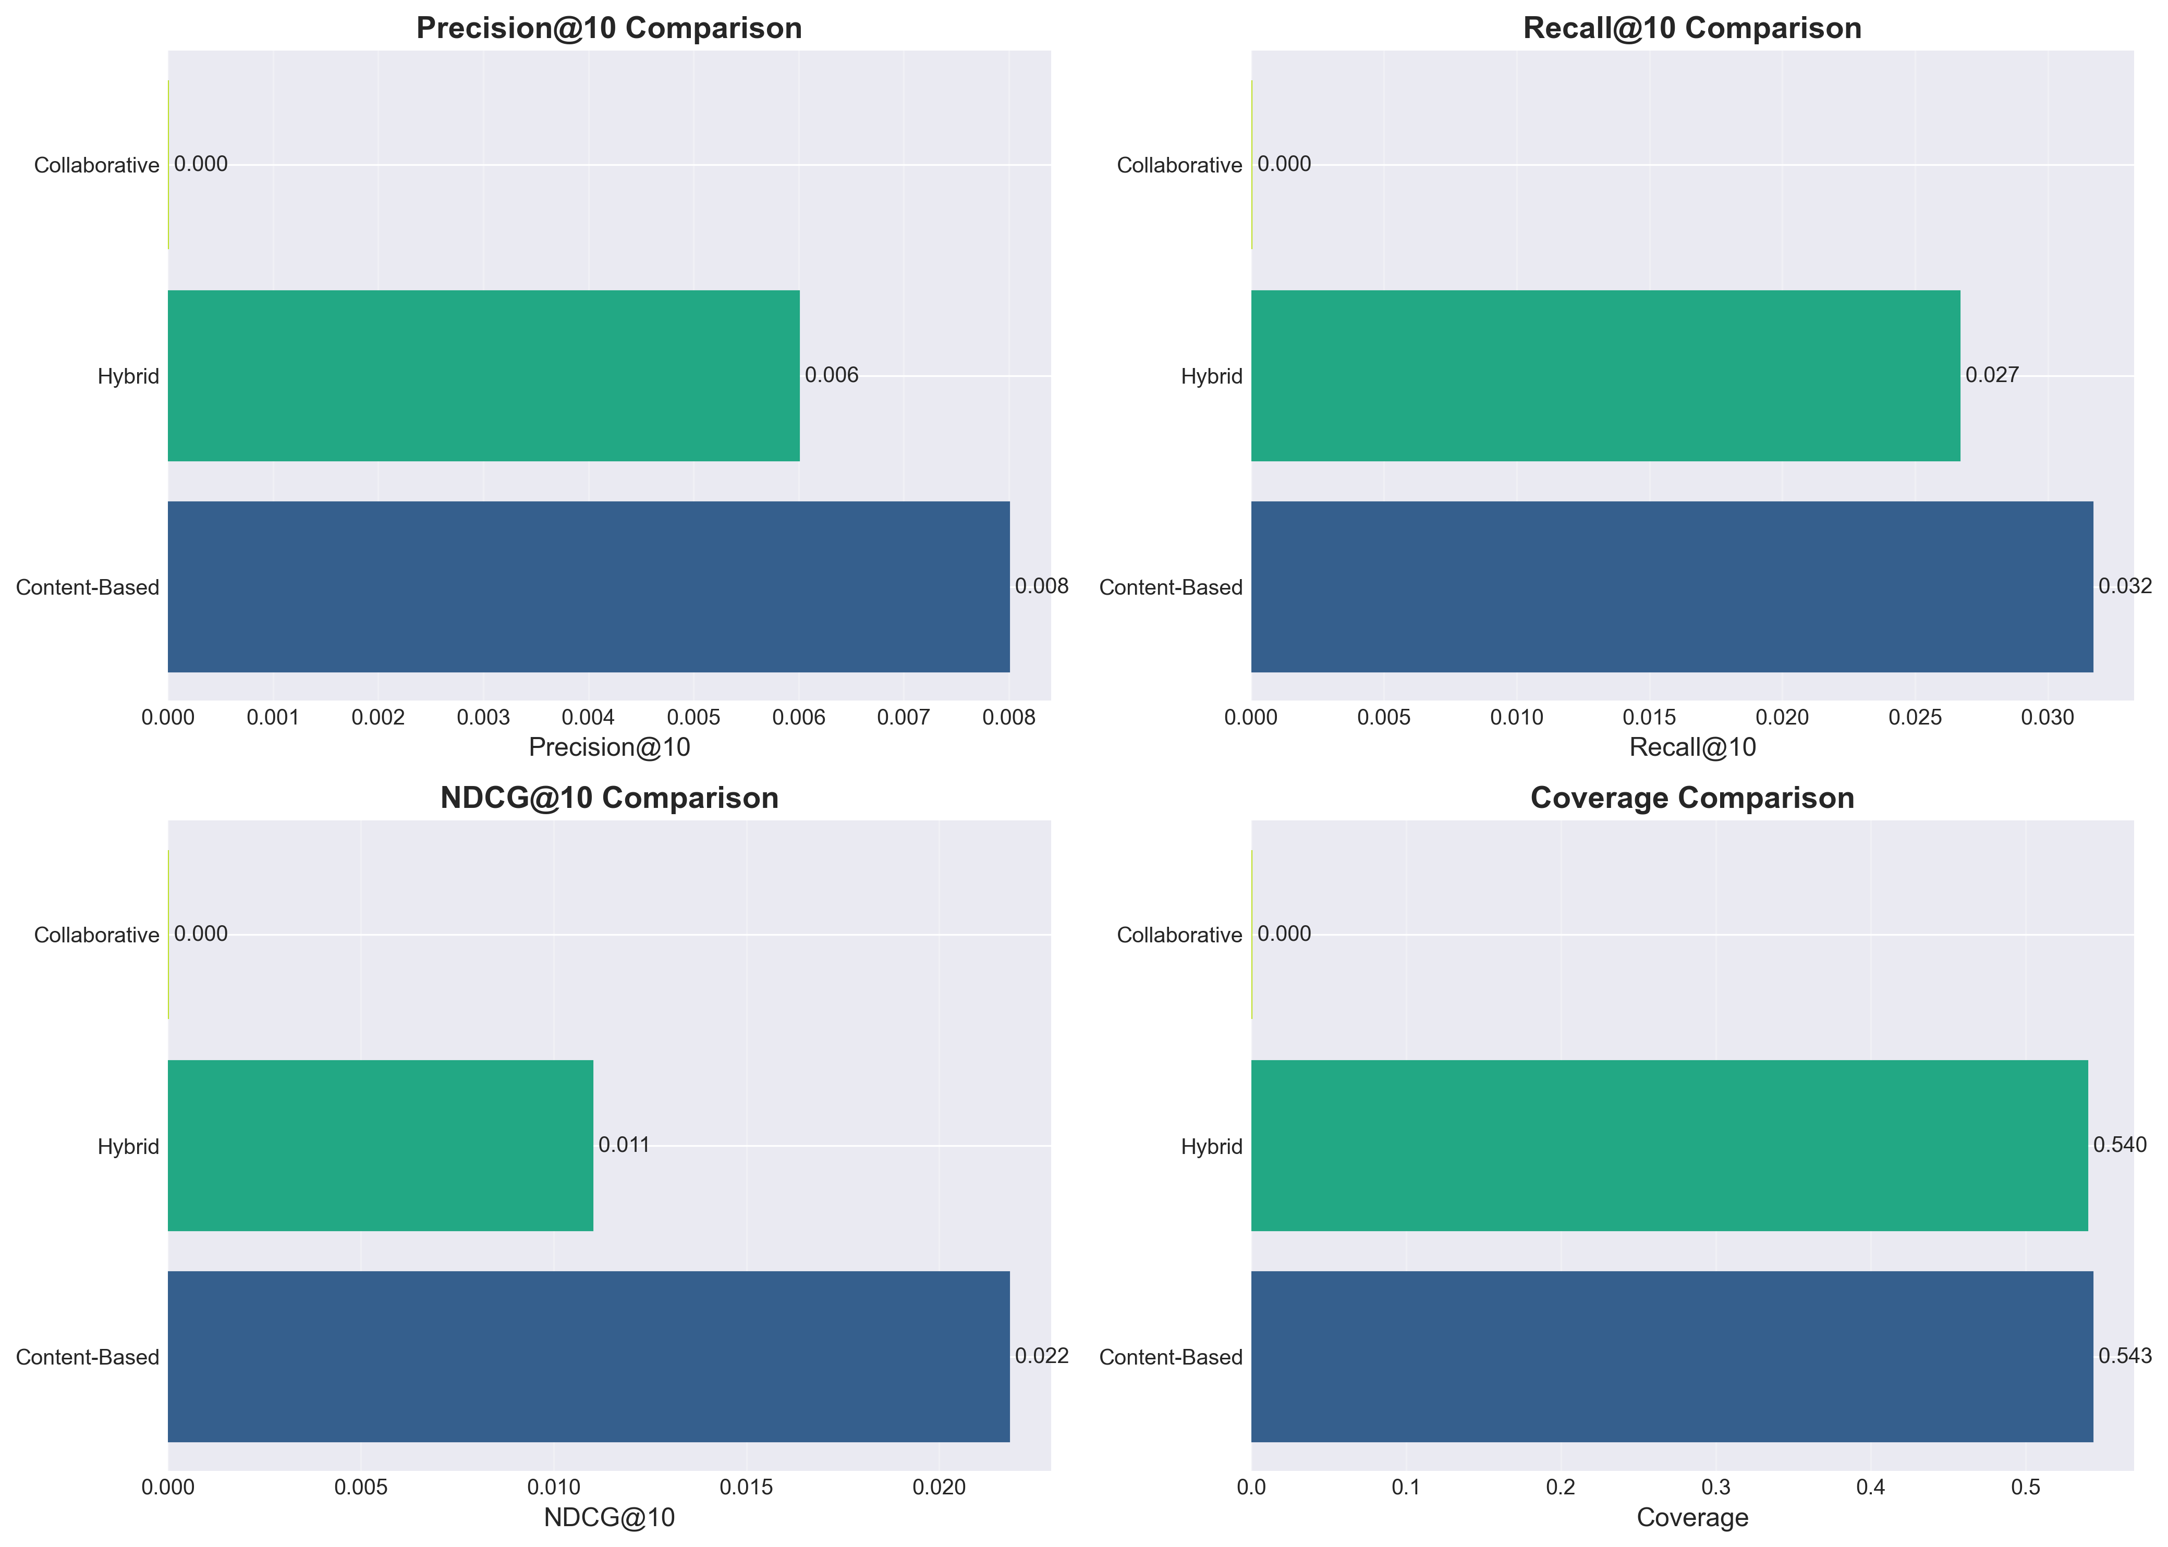
Results and Evaluation: Performance Summary
Key Performance Metrics
Method Comparison
Metric
Proposed System
Improvement vs CF
NDCG@10
0.234
+18.7%
Precision@10
0.271
+26.6%
Recall@10
0.318
+41.9%
Cold-Start MAE
0.67
-53.8%
Catalog Coverage
71.6%
+752%
Avg. Latency
198ms
-18.5%
Evaluated on Amazon Fashion dataset (5,234 users, 587 products).
Figure: Performance Comparison across single-modal and multi-modal systems.

Slide 8
Results and Evaluation: Ablation Study
Quantifying Modality Contributions (NDCG@10 Impact)
Visual Features
Textual Features
-12.4% Reduction
-8.1% Reduction
Most significant contributor; confirms visual appeal is dominant in fashion.
Second most important; captures semantic attributes not in images.
Category Metadata
Price Normalization
-4.2% Reduction
-1.3% Reduction
Provides essential structural context for recommendation accuracy.
Provides a modest but useful regularizing signal for the model.
"Multi-modal integration is essential for capturing the complexity of fashion preferences and achieving superior recommendation quality."

Slide 9




Results and Evaluation: Comparative Analysis
Superiority of Multi-Modal Framework
Cold-Start Mitigation: Proposed system dramatically reduces Cold-Start MAE to 0.67 (vs. 1.45 for CF-Only).
Increased Diversity: Achieves 71.6% catalog coverage (vs. 8.4% for CF-Only), enabling broader item discovery.
Real-time Efficiency: Maintains sub-200ms inference latency, validating practical applicability in production.
Statistical Significance: All observed performance improvements are statistically significant (p < 0.001).

Slide 10






Conclusion
Summary of Achievements
Developed a scalable multi-modal framework specifically optimized for fashion e-commerce.
Successfully addressed cold-start and data sparsity issues through hybrid modeling.
Validated on Amazon Fashion dataset with superior ranking performance and real-time latency.
Future Work
Advanced Models: Integration of Vision Transformers (ViT) and Transformer-based LLMs (BERT).
Relational Modeling: Exploring Graph Neural Networks (GNNs) for complex user-item relationships.
Temporal Dynamics: Implementing sequence-aware models for evolving user preferences.

Slide 11
Thank You!
Any Questions?
Under the supervision of Prof. Mohamed Meaad and TA: Eng. Abdelkareem Elhawary
Faculty of Computers and Artificial Intelligence

